Slide 1


<Lecture Name =”Research on Ethical Hacking”
Lecturer =”Toktam Ramezanifarkhani”
Affiliation =”University of Oslo”
Email =”toktamr@ifi.uio.no”
/>

Slide 2
Overview
Aspects of Information Security
Introduction of ethical hacking
Classification of security attacks
Research

Slide 3
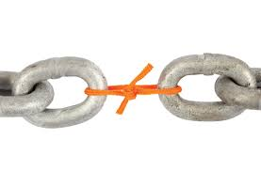


Aspects of Information Security
Security attack:
Threat:
Vulnerability:
Any action that compromises the security of information owned by an organization
A potential for violation of security
A way by which loss can happen
Processing or communication service that are intended to counter security attacks (access controls)
Security mechanism (control):
A process that is designed to detect, prevent, or recover from a security attack (digital signatures)
Security service:

Slide 4
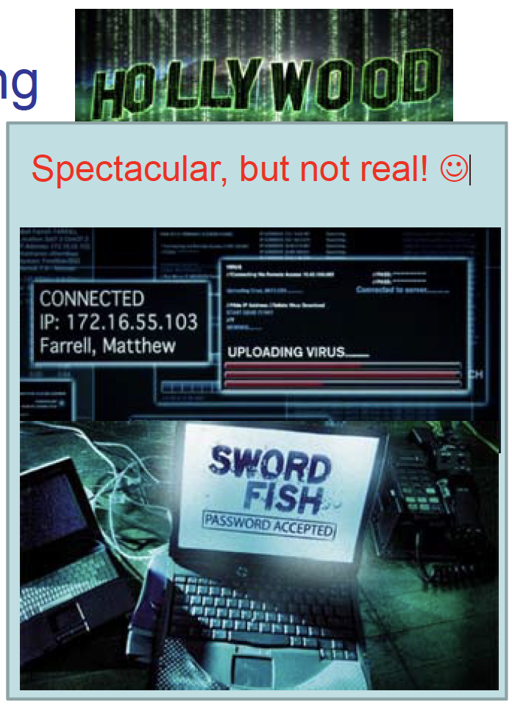
What is Ethical Hacking?
The practice of employing computer and network skills in order to assist organizations in testing their network security for possible vulnerabilities.
Ethical Hacking:
White Hats:
also known as security analysts or ethical hackers, are the individuals or experts who perform ethical hacking.

Slide 5
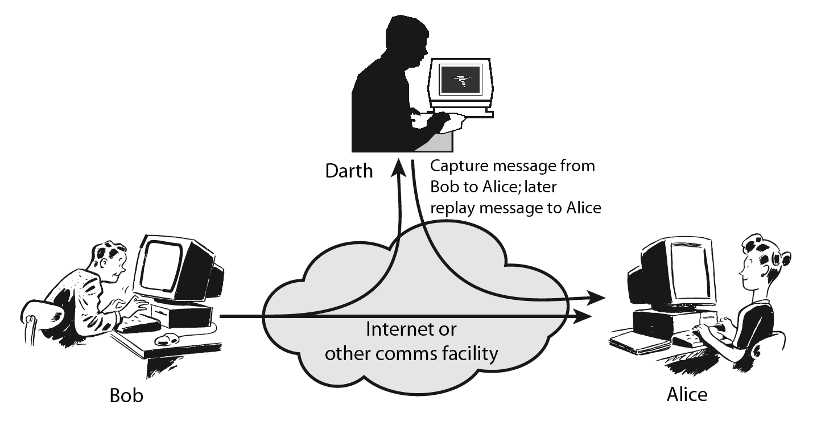
Attack Classification
Passive Attack - Interception
Active Attack: Replay

Slide 6
Attacks and Defense
Defense:
focus on detection and recovery
Passive attacks
Easy to stop: hiding
Hard to detect: non visibility
Active attacks
Hard to stop: complicated
Easy to detect: visibility
Defense: focus on prevention

Slide 7
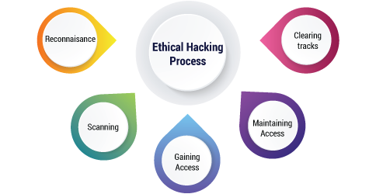
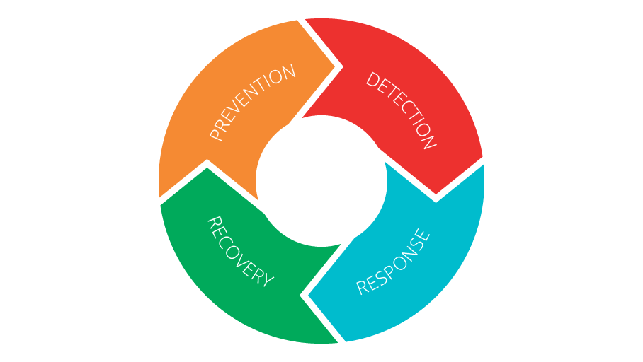

The information security battle
Ethical hacking process
Security mechanism, control and services
Notes:
Reconnainsess identification of the target system

Slide 8


Research!

Slide 9

Contributions – examples
Digital Intelligent Security Services based on Vehicle Data [3] - Behavioral Authentication using ML
Detecting imminent attacks and recovery - Flow Integrity: Specification and Enforcement [1]
IAVS- Intelligent Active Network Vulnerability Scanner - Vulnerability scanners, reconnaissance phase of EH [4]
Standards, and Requirements - Classification of Security Requirements of Software Systems [2], General Data Protection Regulation (GDPR) [5]
Prevention: Language-based security[10] - Interaction Non-interference Distributed OO Systems [9], IoT DDOS [11]
Response: Decision-Making Systems Software Development Process in Crisis Situations [8]
Securing IoT Architecture (target system) [6]
Std.
Vul.
Srv.
Det.
Prev.
Trg.
Resp.
Notes:
Active vulnerability scanners applied at an initial step in ethical hacking suffer from serious deficiencies such as heavy scan
traffic during the reconnaissance phase, uncertainty in the environment, and heavy reliance on experts. Generating a blind heavy
load of attack packets not only causes usage of network resources, but it is stopped by the target defense systems that causes
failure in finding vulnerabilities. Utilizing a decision-making method devised for uncertainty conditions, we present Intelligent
Active Network Vulnerability Scanner (IAVS). IAVS is implemented as an extension on Hail Mary, the automatic execution
mechanism in the Metasploit toolkit. IAVS learns from previous vulnerability exploitation attempts to select exploit codes.
IAVS reduces the role of experts in the process of vulnerability testing and decreases the volume of scanning requests during
the reconnaissance phase by integrating the reconnaissance and exploitation phases. Our experiments compared the results of
IAVS and those of Hail Mary without the IAVS extension; these results show that IAVS improved Hail Mary’s successful
attempts.

Slide 10
Classification of Security Requirements of Software Systems
functional and non-functional requirements
methods and tools supporting verification, analysis, and design of functional requirements from the early phases of the project
classifications of software requirements has direct impact on
requirement engineering and software analysis
security requirements as non-functional requirements
security validation and verification are deferred until the test phase with high costs
isolated security engineering process: extra overhead as a non-standard process and decreases integrity of analysis.

Slide 11
Contributions – examples
Digital Intelligent Security Services based on Vehicle Data [3] - Behavioral Authentication using ML
Detecting imminent attacks and recovery - Flow Integrity: Specification and Enforcement [1]
IAVS- Intelligent Active Network Vulnerability Scanner - Vulnerability scanners, reconnaissance phase of EH [4]
Standards, and Requirements - Classification of Security Requirements of Software Systems [2], General Data Protection Regulation (GDPR) [5]
Prevention: Language-based security[10] - Interaction Non-interference Distributed OO Systems [9], IoT DDOS [11]
Response: Decision-Making Systems Software Development Process in Crisis Situations [8]
Securing IoT Architecture (target system) [6]
Std.
Vul.
Srv.
Det.
Prev.
Trg.
Resp.

Slide 12
IAVS- Intelligent Active Network Vulnerability Scanner
Reconnaissance target
Vulnerability identification
Exploiting
Three major phases
Three Major challenges
Wasting network resources
Triggering target networks defense systems
Heavy reliance on experts
IAVS intelligently prioritizes the exploit codes based on attack experiences in the same network
Decreasing dependency to Cybersecurity experts
Increasing the efficiency in identifying vulnerable machines
Running the identification phase and the attack phase interleaving
37% reduction of unsuccessful execution of exploits

Slide 13
Contributions – examples
Digital Intelligent Security Services based on Vehicle Data [3] - Behavioral Authentication using ML
Detecting imminent attacks and recovery - Flow Integrity: Specification and Enforcement [1]
IAVS- Intelligent Active Network Vulnerability Scanner - Vulnerability scanners, reconnaissance phase of EH [4]
Standards, and Requirements - Classification of Security Requirements of Software Systems [2], General Data Protection Regulation (GDPR) [5]
Prevention: Language-based security[10] - Interaction Non-interference Distributed OO Systems [9], IoT DDOS [11]
Response: Decision-Making Systems Software Development Process in Crisis Situations [8]
Securing IoT Architecture (target system) [6]
Std.
Vul.
Srv.
Det.
Prev.
Trg.
Resp.

Slide 14


12/4/19
Attacks: Car Thief
Passive Keyless Entry attack:
This video demonstrates widely used Passive Keyless Entry System is vulnerable to relay attack !
https://www.youtube.com/watch?v=bXfp8F4J2eI

Slide 15
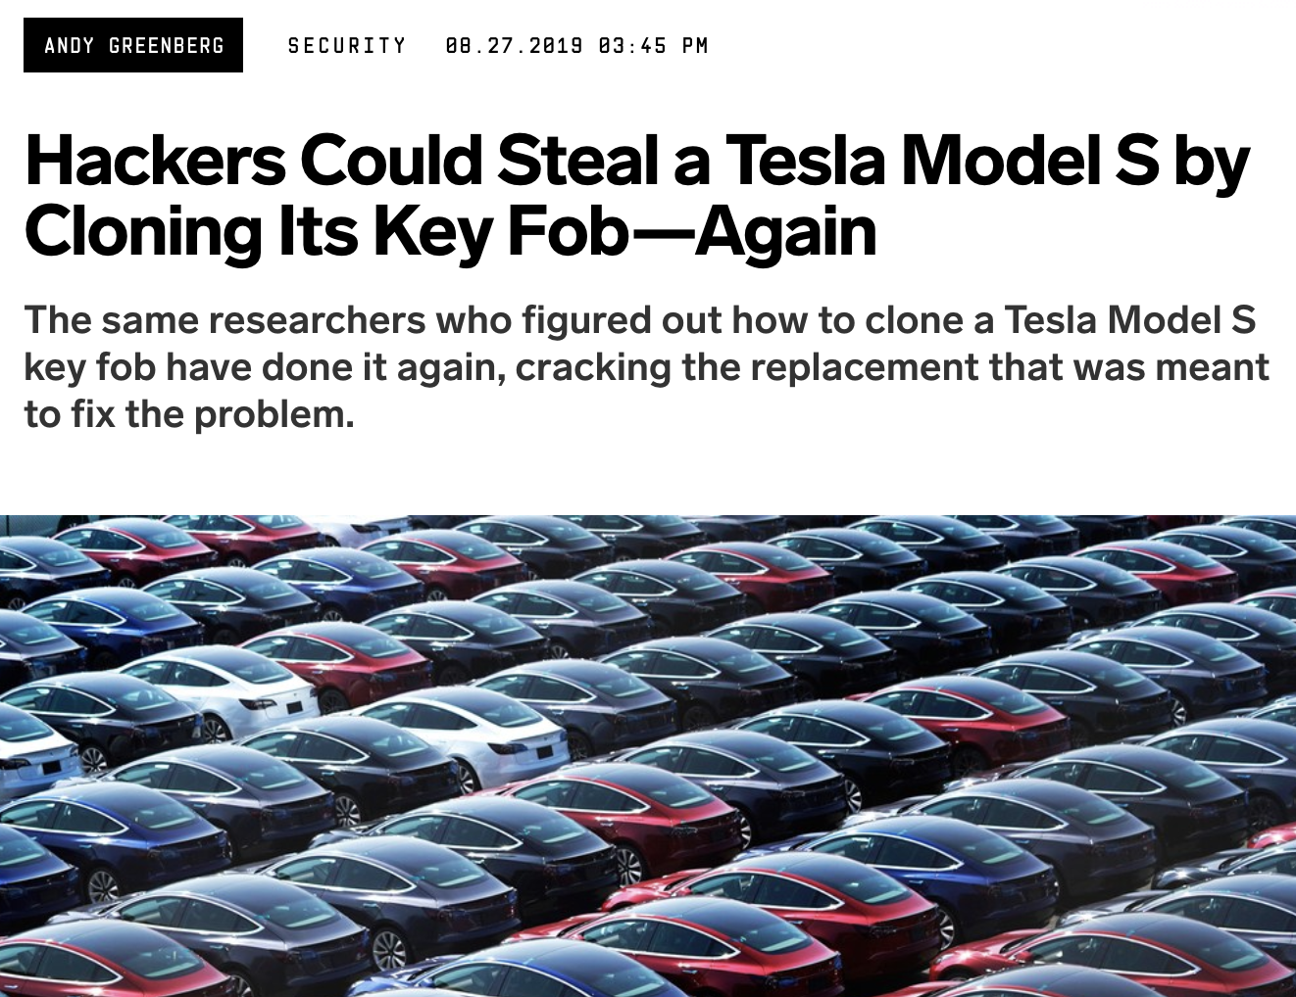
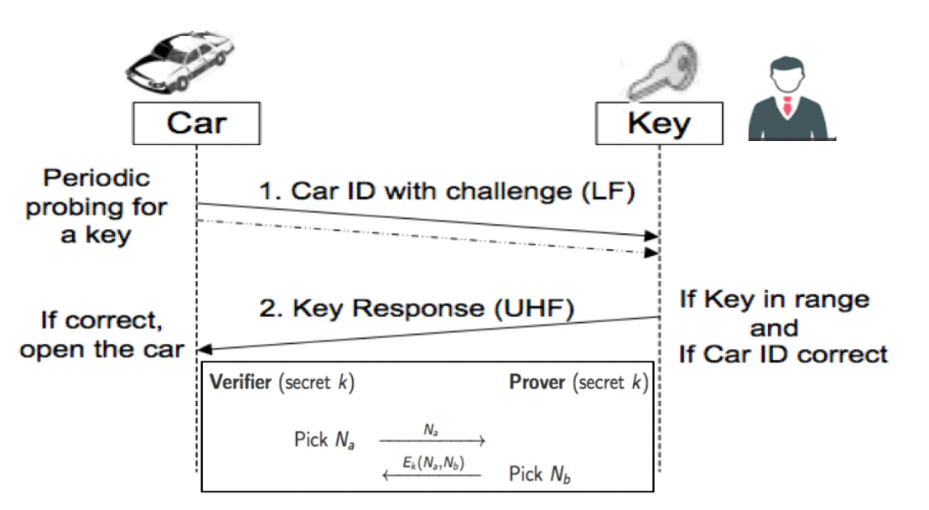
12/6/19
Passive keyless entry systems (PKES)
Behavioral Authentication of the Driver
SECURITY 08.27.2019 03:45 PM
PKES protocol is vulnerable to relay attack
cracking the encryption about a trillion times harder
Ongoing Hack and patch!
finding the key is only twice as hard as before.
Attack defence in different layers
Behavioral Authentication by analysis on vehicle CANbus dataset using Artificial Intelligent and Machine Learning
Based on the derived statistics to have an additional means of authentication
Machine learning can be based on different data
Acceleration, hard brakes, sharp turning
Notes:
Passive keyless entry systems (PKES)
Behavioral Authentication using Machine Learning
Based on the derived statistics to have an additional means of authentication
Machine learning can be based on different data
Acceleration, hard brakes, sharp turning
Distance bounding protocol
one entity measures an upper-bound on its distance to the other
Attackers are trying to decrees the delay and there are several kinds of fraud
Physical Biometric Authentication
face, voice, ear shape
user efficiency, time consumption, authentication precision
Hardware support
Behavioral Driver Authentication - Machine learning

Slide 16
Contributions – examples
Digital Intelligent Security Services based on Vehicle Data [3] - Behavioral Authentication using ML
Detecting imminent attacks and recovery - Flow Integrity: Specification and Enforcement [1]
IAVS- Intelligent Active Network Vulnerability Scanner - Vulnerability scanners, reconnaissance phase of EH [4]
Standards, and Requirements - Classification of Security Requirements of Software Systems [2], General Data Protection Regulation (GDPR) [5]
Prevention: Language-based security[10] - Interaction Non-interference Distributed OO Systems [9], IoT DDOS [11]
Response: Decision-Making Systems Software Development Process in Crisis Situations [8]
Securing IoT Architecture (target system) [6]
Std.
Vul.
Srv.
Det.
Prev.
Trg.
Resp.

Slide 17
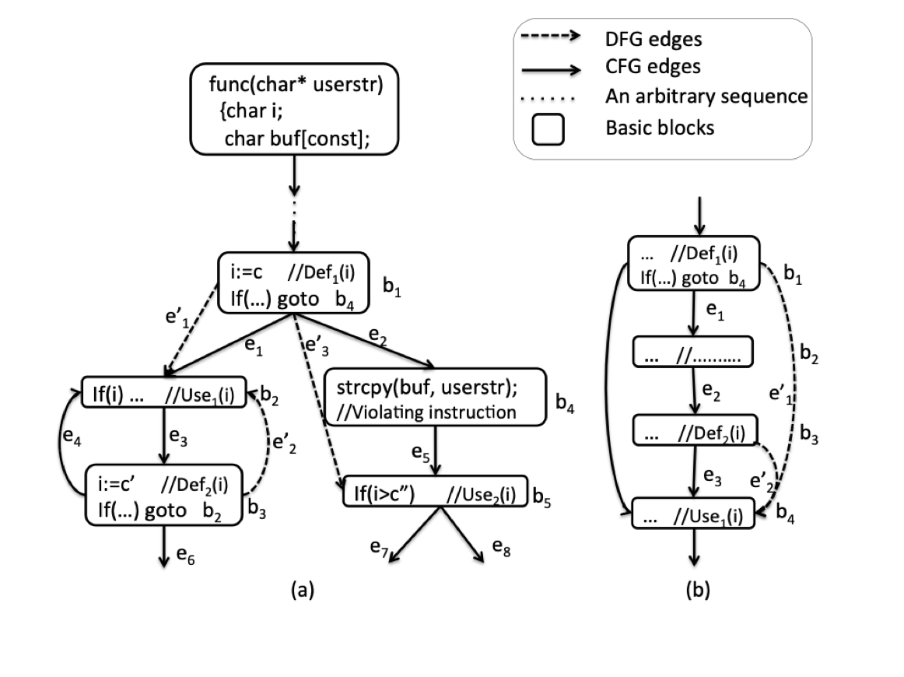
Flow Integrity: Specification and Enforcement
Detect Attacks that change program behaviour at runtime
common and critical software attacks
arbitrary control program behavior by subverting its control flow at runtime
A combination of static and dynamic analysis
Based on data flow and control flow analysis
Control Flow Integrity and Data Flow Integrity
Notes:
Data Flow Integrity: Specification and Enforcement
True Runtime Data Flow: RP=(s,...,bi,...,bj,...,t)∈P, rdf :Def(v)→Use(v) ∈RP
rdf is expected in rp and rdf∈DFG rdf is true
DFI is a security policy that dictates every runtime data flow of a program execution should be a true data flow.

Slide 18
Contributions – examples
Digital Intelligent Security Services based on Vehicle Data [3] - Behavioral Authentication using ML
Detecting imminent attacks and recovery - Flow Integrity: Specification and Enforcement [1]
IAVS- Intelligent Active Network Vulnerability Scanner - Vulnerability scanners, reconnaissance phase of EH [4]
Standards, and Requirements - Classification of Security Requirements of Software Systems [2], General Data Protection Regulation (GDPR) [5]
Prevention: Language-based security[10] - Interaction Non-interference Distributed OO Systems [9], IoT DDOS [11]
Response: Decision-Making Systems Software Development Process in Crisis Situations [8]
Securing IoT Architecture (target system) [6]
Std.
Vul.
Srv.
Det.
Prev.
Trg.
Resp.

Slide 19
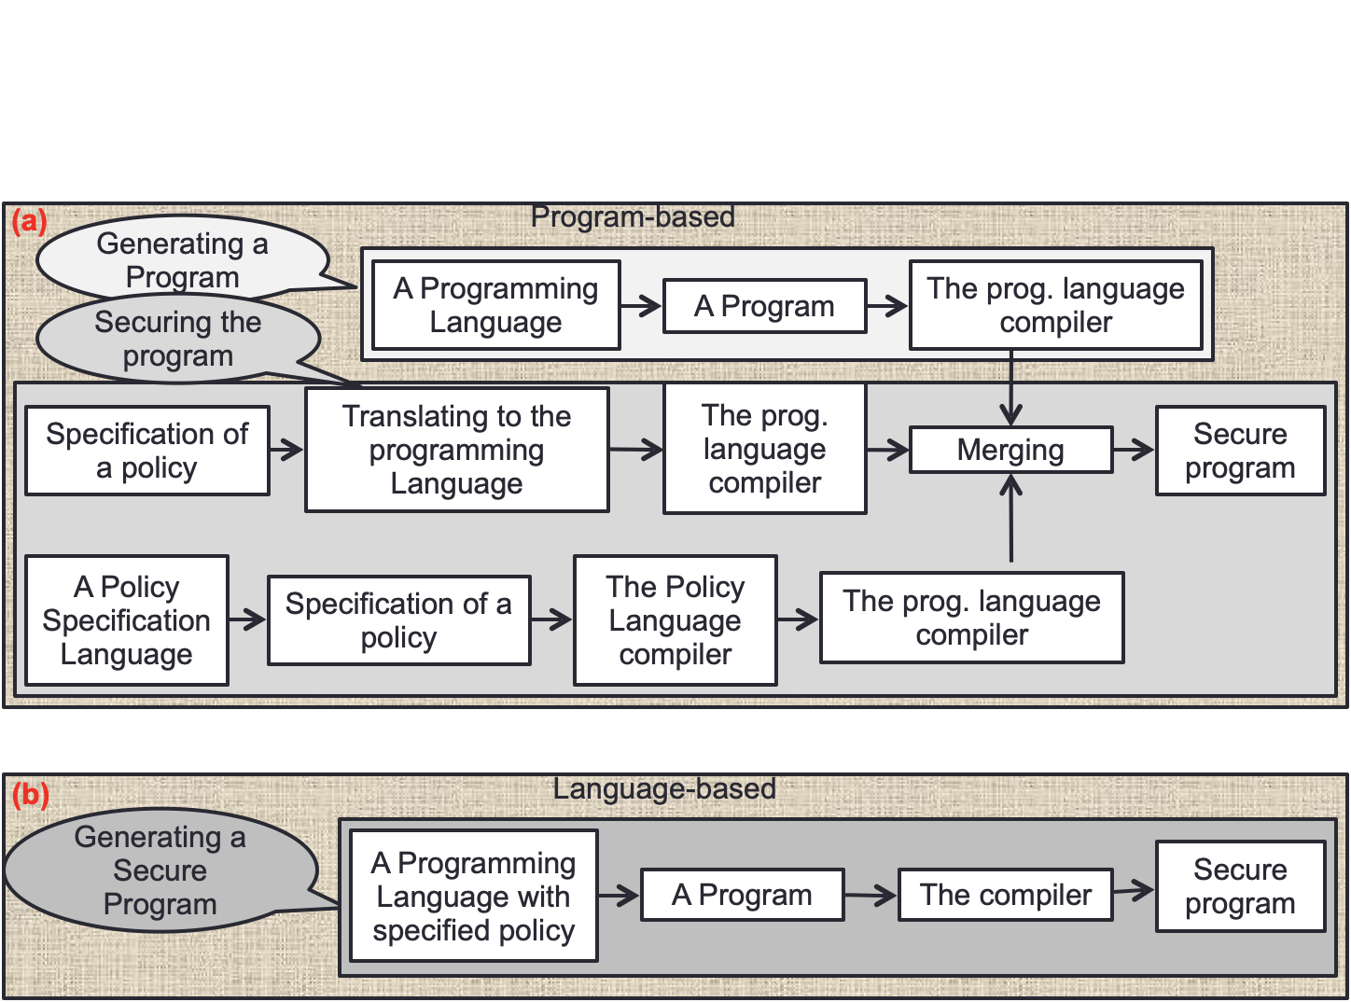
Language-based security
Attack prevention – policy specification and enforcement
Language-based security with run-time guarantees
Extending Attribute Grammars (AGs) capabilities to support IRM as a built-in language feature
Inline Monitoring Attribute Grammar (IMAG)

Slide 20
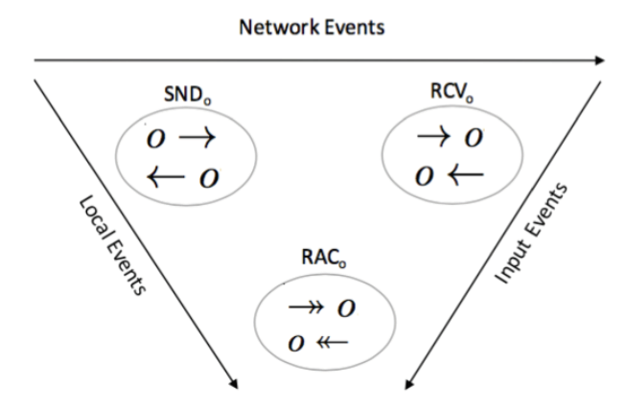
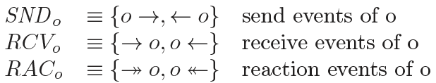
Interaction Non-interference Distributed OO Systems
Security policies as trace properties
security policies as hyper properties
characterized as sets of trace properties such as information flow policies e.g. non-interference
difficulties in specification, enforcement and reasoning,
especially in complicated systems Distributed OO Systems
with non-deterministic objects , due to non-deterministic queues of incoming messages
internal process queues
Notes:
This paper aims to preserve secrecy by avoiding confidential information leakage by specification and enforcement of the
non-interference policy, which is a non-trivial challenge when considering modern distributed systems involving concurrency
and communication. Non-interference is an information flow policy stipulating that low-level viewers should not be able
to observe a difference between any two executions with the same low-level inputs. Only high-level viewers may observe
confidential output or any behavioral differences that reveal confidential data or information. The present paper addresses this
challenge by choosing language mechanisms that are useful for programming distributed systems and allow modular system
analysis. We consider a general concurrency model for distributed systems based on concurrent objects communicating by
asynchronous methods. This model is suitable for the modeling of modern service-oriented systems and gives rise to efficient
interaction. We also avoid unnecessary restrictions on information flow between confidential and non-confidential data, which
is more realistic. Due to the non-deterministic nature of concurrent and distributed systems, we define a notion of interaction
non-interference policy tailored to this setting. We provide two kinds of static analysis: a secrecy-type system and a trace
analysis system, to capture inter-object and network-level communication, respectively. Application of both of these analyses
for exploit and malware detection is one of the future work. We prove that interaction non-interference is satisfied by the
combination of these analysis techniques. Thus any deviation from the policy caused by implicit information leakage visible
through observation of network communication patterns can be detected. The paper’s contribution lies in the definition of the
notion of interaction non-interference, and in the formalization of a secrecy type system and a static trace analysis that together
ensure interaction non-interference. We also provide several versions of the main example (a news subscription service) to
demonstrate network leakage.

Slide 21
Contributions – examples
Digital Intelligent Security Services based on Vehicle Data [3] - Behavioral Authentication using ML
Detecting imminent attacks and recovery - Flow Integrity: Specification and Enforcement [1]
IAVS- Intelligent Active Network Vulnerability Scanner - Vulnerability scanners, reconnaissance phase of EH [4]
Standards, and Requirements - Classification of Security Requirements of Software Systems [2], General Data Protection Regulation (GDPR) [5]
Prevention: Language-based security[10] - Interaction Non-interference Distributed OO Systems [9], IoT DDOS [11]
Response: Decision-Making Systems Software Development Process in Crisis Situations [8]
Securing IoT Architecture (target system) [6]
Std.
Vul.
Srv.
Det.
Prev.
Trg.
Resp.
Notes:
Active vulnerability scanners applied at an initial step in ethical hacking suffer from serious deficiencies such as heavy scan
traffic during the reconnaissance phase, uncertainty in the environment, and heavy reliance on experts. Generating a blind heavy
load of attack packets not only causes usage of network resources, but it is stopped by the target defense systems that causes
failure in finding vulnerabilities. Utilizing a decision-making method devised for uncertainty conditions, we present Intelligent
Active Network Vulnerability Scanner (IAVS). IAVS is implemented as an extension on Hail Mary, the automatic execution
mechanism in the Metasploit toolkit. IAVS learns from previous vulnerability exploitation attempts to select exploit codes.
IAVS reduces the role of experts in the process of vulnerability testing and decreases the volume of scanning requests during
the reconnaissance phase by integrating the reconnaissance and exploitation phases. Our experiments compared the results of
IAVS and those of Hail Mary without the IAVS extension; these results show that IAVS improved Hail Mary’s successful
attempts.

Slide 22
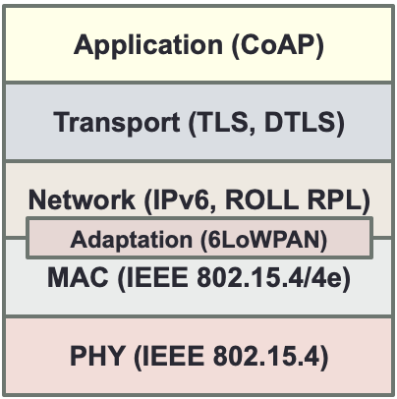
Securing the Internet of Things with Recursive InterNetwork Architecture (RINA)
Repeated functionality in layers/protocols
Security and performance enhancement conflict
Attack repetition
Not compatible together and for future extensions
Domain synergy
App.
Node1
Node2
App.
Router1
Router2
IPCP
IPCP
2-DIF
IPCP
IPCP
IPCP
1-DIF
IPCP
IPCP
1-DIF
IPCP
IPCP
1-DIF
IPCP
A typical IoT network stack with common protocols
Distributed IPC Facilities (DIF)
Notes:
Adopts the basic foundation of networking:
“Networking is Inter-Process Communication (IPC) and only IPC”.

Slide 23
Contributions – examples
Digital Intelligent Security Services based on Vehicle Data [3] - Behavioral Authentication using ML
Detecting imminent attacks and recovery - Flow Integrity: Specification and Enforcement [1]
IAVS- Intelligent Active Network Vulnerability Scanner - Vulnerability scanners, reconnaissance phase of EH [4]
Standards, and Requirements - Classification of Security Requirements of Software Systems [2], General Data Protection Regulation (GDPR) [5]
Prevention: Language-based security[10] - Interaction Non-interference Distributed OO Systems [9], IoT DDOS [11]
Response: Decision-Making Systems Software Development Process in Crisis Situations [8]
Securing IoT Architecture (target system) [6]
Std.
Vul.
Srv.
Det.
Prev.
Trg.
Resp.

Slide 24
A Crisis Situations Decision-Making
Systems Software Development Process
Agile processes
can manage uncertainty in software requirements
Incremental development can solve some problems in developing CSDMSs
Extreme Programming (XP)
widely-used agile processes
Software development process: Crisis Situations Decision-Making Systems (CSDMSs)
A customized version of XP
CSDP has been able to practically tackle the challenges of development when
the lack of crisis-related knowledge with difficulty of extracting knowledge,
CSDMSs: Customer/user does not know much about what they should expect/need! CSDMSs rely on simulators a lot.
Acceptance tests are black box system tests by non-expert costumers, simulation + performance test
The extraction of user stories requires a procedure by business expert role and tester
Notes:
Standing first and second in five national and international RoboCup rescue agent
simulation tournaments from 2006 to 2010 bear witness to the efficiency of the developed software using
CSDP.
urgent need to overcome security challenges
CSDMSs: Customer/user does not know much about what they should expect/need! CSDMSs rely on simulators a lot.
The main differences with XP:
XP:
1) user stories are mentioned by the customer+user. They are things that the system needs to do for them. User stories also drive the creation of the acceptance tests. User stories should only provide enough detail to make a reasonably low risk estimate of how long the story will take to implement.
2) Acceptance tests are black box system tests. Each acceptance test represents some expected result from the system. Customers are responsible for verifying the correctness of the acceptance tests and reviewing test scores.
3) Collective Ownership encourages everyone to contribute new ideas to all segments of the project.
CSDP:
1) the extraction of user stories requires a procedure which is dependent on business expert role and tester. The business expert helps extract stories and finding simulators, and the tester helps find a problem solution for each problem situation.
2) tester monitors other systems/simulators to find new problem scenarios since no simulator is able to completely model the domain.
3) Robustness is insured by adding an activity called ‘performance test’ to the iteration procedure. The performance test activity is a semi-automatic activity which for each small release fully tests efficiency of released version through both machine and expert human assessment. to a comprehensive collection of problem scenarios which have been collected previously and are updated continuously by tester.
4) Collective Ownership: programming teams are required to report the bugs belonging to other system development teams to the tester so that he is able to record the exact information about the bugs and report them to the respective development team..

Slide 25
Thanks!
Toktamr@ifi.uio.no

Slide 26
References
[1] T. Ramezanifarkhani, M. R. Razzazi, “Principles of Data Flow Integrity: Specification and Enforcement”, Journal of Information Science and Engineering, Vol. 31, No. 2, 529-546, 2015.
[2] T. Ramezanifarkhani, M. R. Razzazi, Examination and Classification of Security Requirements of Software Systems", In 2nd IEEE International Conference on Information & Communication Technologies: from Theory to Applications, ICTTA’06, 2006.
[3] T. Ramezanifarkhani, P. Teymoori, “Digital Intelligent Services based on Vehicle Data”, SCOTT Vehicle Data Hackathon, Gdansk, 2019, http://heim.ifi.uio.no/toktamr/papers/Hackathon.pdf.
Toktam Ramezanifarkhani, Peyman Teymoori, "New ideas in 7 categories such as security, safety, and ecofriendly on vehicle CANbus dataset using Artificial Intelligent Presented at Vehicle Hackaton in SCOTT project, Gdansk, 2019, Won the second prize. ".
[4] M. Bazrafkan, A. Nowroozi, T. Ramezanifarkhani, P. Teymoori, "IAVS: Intelligent Active Network Vulnerability Scanner."In Norsk IKT-konferanse for forskning og utdanning, no. 3. 2020.
[5] S. Tokas, O. Owe and T. Ramezanifarkhani, “Static Checking of GDPR-Related Privacy Compliance for Object-Oriented Distributed Systems”, Journal of Logical and Algebraic Methods in Programming, submitted April 2019.
[6] T Ramezanifarkhani, P. Teymoori, “Securing the Internet of Things with Recursive InterNetwork Architecture (RINA)”, In the proceedings of International Conference on Computing, Networking and Communications, (ICNC 2018), Maui, Hawaii, USA, March 5-8, 2018.
[7] Mathew, Thomas. "Ethical Hacking and Countermeasures [EC-Council Exam 312-50]—Student Courseware." (2004).
[8] A. Nowroozi, P. Teymoori, T. Ramezanifarkhani, et al. “A Crisis Situations Decision-Making Systems Software Development Process with Rescue Experiences."IEEE Access, 2020.
[9] T. Ramezanifarkhani, O. Owe, S Tokas, “A Secrecy-Preserving Language for Programming of Object-Oriented and Distributed Systems”, Journal of Logical and Algebraic Methods in Programming, 2016.
[10] T. Ramezanifarkhani, M. R. Razzazi, “Inlined Monitoring Attribute Grammars to Enforce Security Policies”, Submitted to ACM Transactions On Programming Language and Systems, 43 pages.
[11] iot ddos
Notes:
Active vulnerability scanners applied at an initial step in ethical hacking suffer from serious deficiencies such as heavy scan
traffic during the reconnaissance phase, uncertainty in the environment, and heavy reliance on experts. Generating a blind heavy
load of attack packets not only causes usage of network resources, but it is stopped by the target defense systems that causes
failure in finding vulnerabilities. Utilizing a decision-making method devised for uncertainty conditions, we present Intelligent
Active Network Vulnerability Scanner (IAVS). IAVS is implemented as an extension on Hail Mary, the automatic execution
mechanism in the Metasploit toolkit. IAVS learns from previous vulnerability exploitation attempts to select exploit codes.
IAVS reduces the role of experts in the process of vulnerability testing and decreases the volume of scanning requests during
the reconnaissance phase by integrating the reconnaissance and exploitation phases. Our experiments compared the results of
IAVS and those of Hail Mary without the IAVS extension; these results show that IAVS improved Hail Mary’s successful
attempts.

